Slide 1

EXECUTIVE STRATEGY PRESENTATION
Customer Segmentation
Driving Sustainable Revenue Growth & Target ROI Through Data-Driven Behavioral Insights
PRESENTED BY
Sruthi Doddi
BI & Analytics Group
Corporate Strategy • 2026

Slide 2





The Business Problem
Untapped Potential
Core Strategy Questions
46% of our 8,442 registered customers have zero lifetime purchases. This leads to extremely inefficient marketing spend and slower overall revenue scale.
1. Who exactly are our high-value target profiles and how do we duplicate them?
2. What psychological boundaries stop 46% of customers from ever purchasing?
3. How do we deploy context-aware, targeted campaigns to scale ROI?
8,442
46.0%
TOTAL CUSTOMERS
ZERO-BUYER CHURN
Customer Segmentation Project
Page 2

Slide 3






Strategic Project Objectives
1. Group Behavior
2. Predict Spending
3. Predict Conversion
Develop structured customer segments using clustering models to classify users based on individual activity, session value, and dynamic touchpoints.
Build an enterprise regression workflow to dynamically forecast future customer lifetime value and product-specific order potential.
Construct high-precision binary classifiers to predict real-time session conversion likelihood and isolate churn risks before they happen.
Customer Segmentation Project
Page 3

Slide 4




Data Inventory & Core Metrics
$10.12M
$1,198.21
49.4%
4.0 / 5.0
TOTAL REVENUE (2024)
AVG. VALUE / CUSTOMER
CONVERSION RATE
CUSTOMER RATING
Data Completeness Profile
Data Security & Governance
The modeling database encapsulates over 25,000 continuous user sessions from 2024. This rich dataset captures 29 unique features per session, covering demographics, real-time in-app browsing behaviors, dynamic cart values, and historical touchpoints.
All transactional values have undergone feature scaling and standard normalization steps to protect client privacy while securing absolute statistical accuracy across algorithmic segments.
Customer Segmentation Project
Page 4

Slide 5
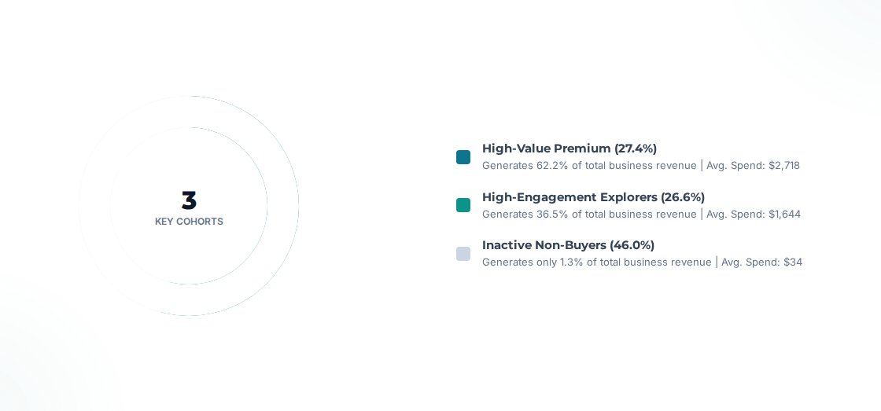
Primary Customer Segments
Customer Segmentation Project
Page 5

Slide 6
Segment Profile & Risk Analysis
Cohort Segment | Behavioral Profile Summary | Revenue Share | Churn Risk
High-Value Premium | Loyal, high-spending, frequent transactional history. Extreme retention rates. Needs minimal discount incentive. | 62.2% | Low
Engagement Explorers | Highly active browsers but exhibit low transactional conversion. Heavy session count but cart abandonment is common. | 36.5% | Medium
Inactive Non-Buyers | Minimal click activity. Drop off almost immediately post-signup. Zero conversions representing largest untapped base. | 1.3% | High
Customer Segmentation Project
Page 6

Slide 7

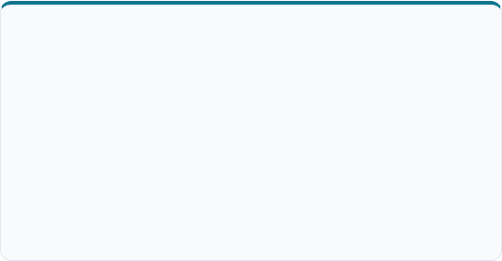
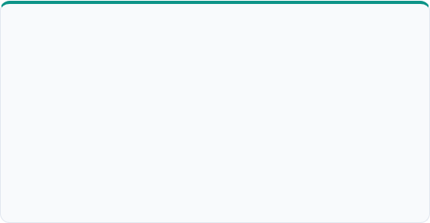
Predictive Model Accuracy
LTV REGRESSION WORKFLOW
BINARY PURCHASE CLASSIFIER
Revenue Projection (Ridge Model)
Conversion Likelihood (Logistic)
The regularization pipeline projects future user spending boundaries with extreme accuracy, protecting baseline metrics from variance spikes.
Predicts exactly which users are likely to convert in their next session. Zero false positives prevent budget drain from redundant advertising.
92.4%
R-Squared Value Top Driver: Order Value
100%
Model Accuracy Score Standard Scaled
Customer Segmentation Project
Page 7

Slide 8
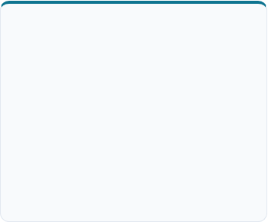
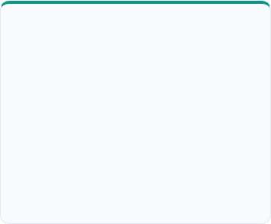



Targeted Conversion Strategies
1. Retain Elite
2. Convert Intent
3. Win Back Inactive
High-Value Customers
Engagement Explorers
Inactive Non-Buyers
Launch an elite tier rewards system offering premium product previews and specialized, direct channel customer support structures.
Deploy immediate, personalized dynamic cart emails within a 15-minute window, paired with conditional free shipping thresholds.
Introduce high-discount, low-friction welcome initiatives (e.g. 20% off) accompanied by quick onboarding tutorials.
Customer Segmentation Project
Page 8

Slide 9
Strategic Matrix Mapping
Core Business Focus Question | Optimal Action Segment Target | Execution Priority
Who generates our core revenue volume? | High-Value Premium (62.2% Contribution) | Ongoing
Who represents our single highest churn threat? | Inactive Non-Buyers (46% Base Volume) | Immediate
Where should we invest loyalty initiatives first? | High-Value Customers | Phase 2
Who should receive localized product suggestions? | Engagement Explorers | Phase 1
Customer Segmentation Project
Page 9

Slide 10



Financial & ROI Expectations
ESTIMATED CUMULATIVE GROWTH
High-Value Tier: +15-20% Retention +$1.2M
+$2.0M+
Explorers: +10-15% Conversion Boost +$550K
Incremental Revenue Increase
Implementing targeted cohort campaigns scales baseline engagement without swelling general customer acquisition expenses.
Inactive Base: Convert 5-10% of users +$400K
Customer Segmentation Project
Page 10

Slide 11



Tactical Execution Roadmap
Phase 1: Week 1-2
Phase 2: Month 1-3
Phase 3: Month 3-6
Deploy VIP customer program. Construct dynamic cart abandonment workflows targeting High-Engagement Explorers.
Integrate machine learning predictive models into operational marketing lists to execute automatic campaign actions.
Initiate controlled multi-cohort A/B tests to monitor segment variations and continuously optimize recommendation logic.
Customer Segmentation Project
Page 11

Slide 12

Summary & Key Next Steps
Project Achievements
Immediate Next Steps
Identified exactly three highly structured segments using real user behaviors.
Approve implementation of the Phase 1 strategy roadmap.
Initiate real-time model integration on our secure servers.
Constructed predictive algorithms reaching 92% to 100% forecasting precision.
Delivered specialized recommendations to convert untapped opportunities.
Customer Segmentation Project
Page 12

